Slide 1



Smart City Planner: Analyzing Urban Data for Better Living.
Submitted by
Sukant R [927623BAD114]
Perumal P [927623BAD074]
Sakthi Sanjuktha S [927623BAD096]

Slide 2
PROBLEM STATEMENT / DESCRIPTION:
The project, "Smart City Planner: Analyzing Urban Data for Better Living", focuses on leveraging IoT sensor data for optimizing urban living. It addresses three critical areas:
Traffic Management: Real-time traffic data integrated with visualization to optimize flow, reduce congestion, and adjust traffic signals dynamically.
Energy Usage: Real-time monitoring of city-wide energy consumption to detect inefficiencies and promote energy-saving strategies.
Environmental Monitoring: Continuous tracking of air and water quality, noise levels, and temperature, with alerts for exceeding environmental thresholds.

Slide 3
ABSTRACT :
“Smart City Planner “ is a Python-based project designed to harness the power of IoT sensor data for optimizing various facets of urban life.
The project focuses on three critical areas: traffic management, energy consumption, and environmental monitoring, using real-time data analytics to inform decision-making.
This project is introduced under the title ‘Info-Share’, a decentralized platform that facilitates real-time data exchange between city departments, businesses, and citizens.
This integration enables improved urban planning, enhances public services, and fosters sustainable growth. By leveraging data-driven insights, the project aims to create a more connected, efficient, and livable urban environment, setting a new benchmark for smart city development.

Slide 4
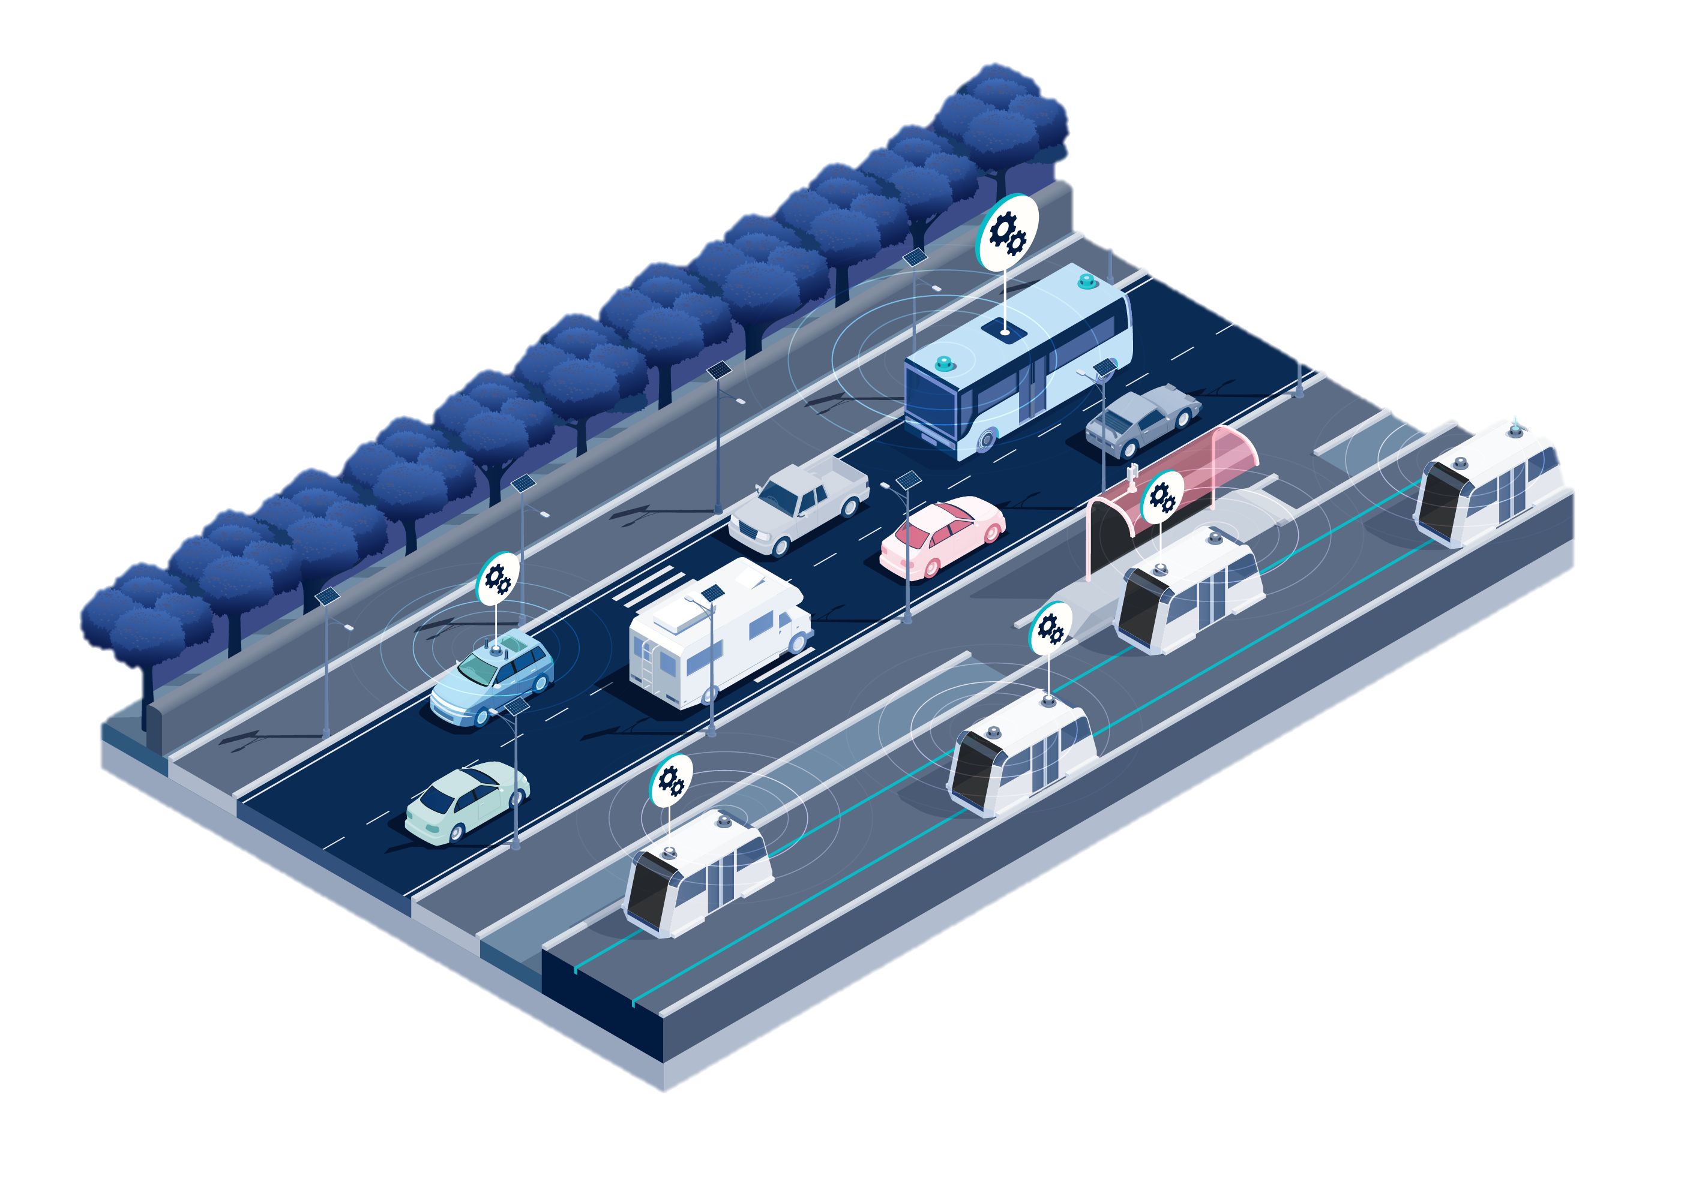
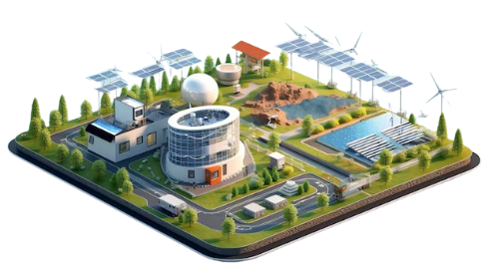
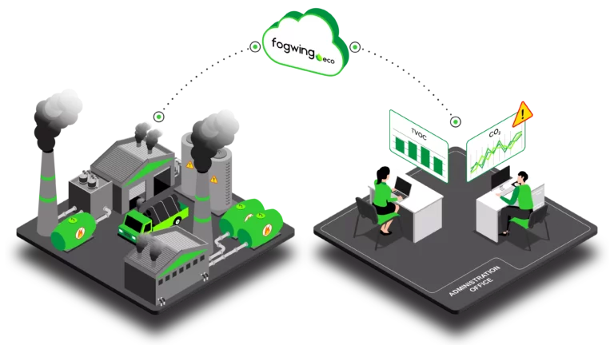
Methodology / DESCRIPTION:
The project uses the following methodologies:
Data Transmission & Processing: IoT sensors collect data which is transmitted and processed for analysis.
Predictive Models: Applied to traffic management and energy optimization.
Data Analytics: Used for decision-making and recommending actions to optimize traffic flow, energy use, and reduce environmental pollution.

Slide 5
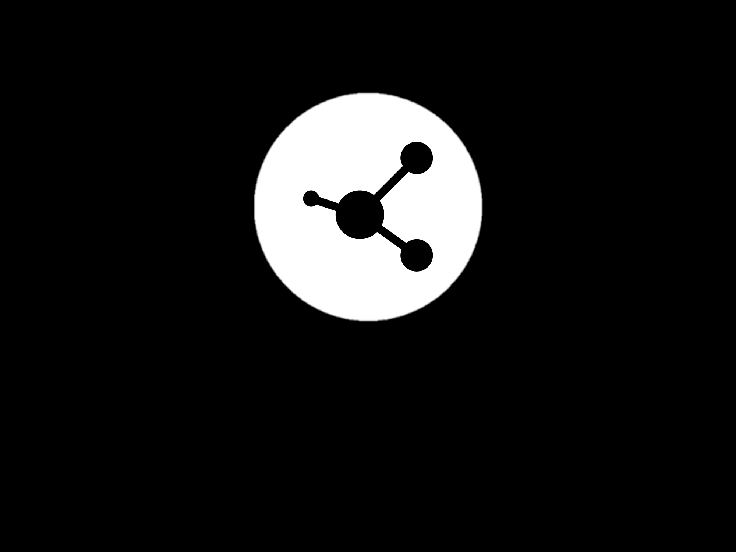
Methodology :
Traffic management
Energy management
Environmental monitoring
District Selection
Smart Grid data
Sensor
API request
Data Transmission
Data Transmission
API access
Data Storage
Data Storage
Data transmission
Data processing
Data processing
Data Analytics
Data Analytics
Data Analytics
Vehicle analysis
Visualize density,etc
Energy Management
Visualize report
Visualize report

Slide 6
Data Collection and Preprocessing:
Sources: IoT sensors deployed across the city for traffic, energy, and environmental data.
Cleaning Techniques: Handling missing values, duplicates, and outliers in the sensor data before analysis with the help of pandas.
Feature Engineering: Extracting meaningful features from the raw sensor data for use in predictive models.

Slide 7
Technology Stack:
Python for data processing and analysis.
Flask (python package) for developing the dashboard interface.
IoT devices for collecting realtime data and cloud-based data storage for storing the large data.
Data visualization libraries such as Matplotlib,folium.
Reasons: Python's versatility with data analytics, Flask for creating web-based interfaces, and scalability through cloud infrastructure.

Slide 8
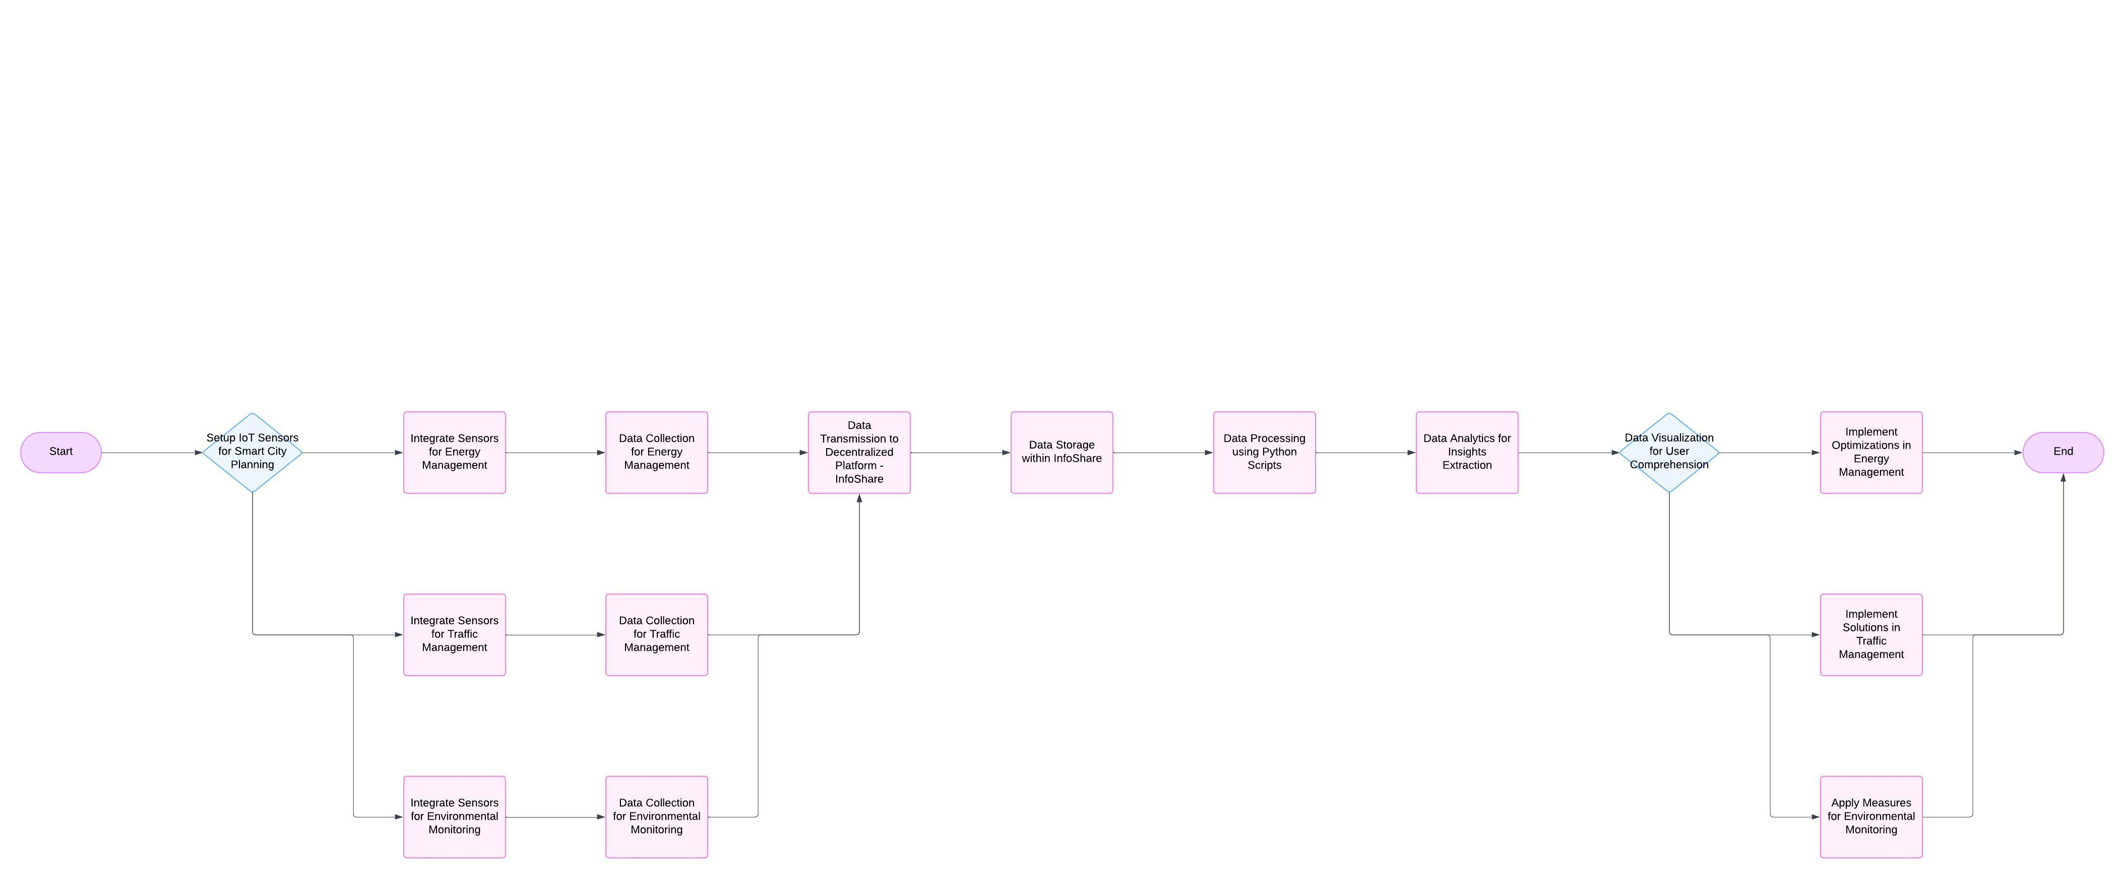
SYSTEM ARCHITECTURE:

Slide 9
Code:
import pandas as pd
import random
from flask import Flask, render_template_string, request
import pandas as pd
import random
from flask import Flask, render_template_string, request
@app.route("/", methods=["GET", "POST"])
def index():
error = None
data = None
if request.method == "POST":
district = request.form.get("district", "").strip()
if not district:
error = "Please enter a valid district name."
else:
# Fetch data for the requested district
district_data = df[df["Area"].str.lower() == district.lower()]
if district_data.empty:
error = f"No data found for district: {district}"
else:
data = district_data.iloc[0].to_dict()
return render_template_string(template, error=error, data=data)
if __name__ == "__main__":
app.run(debug=True)

Slide 10
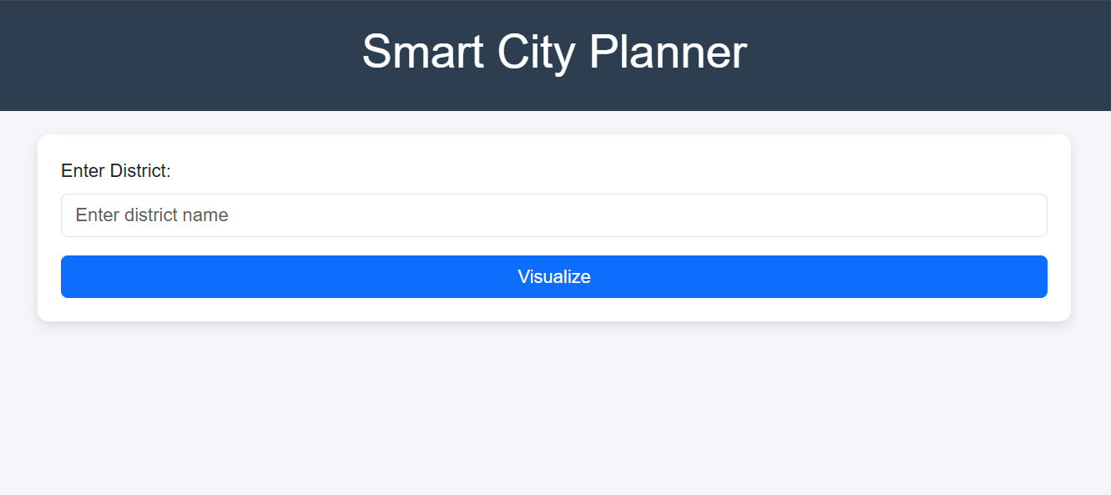
User Interface and Experience Design:
Home Screen:
Displays a search bar and input field where users can type the name of a district
to retrieve detailed visualizations.
User Flow:
The user types in the name of a district (e.g., "Chennai").
Clicking the "Visualize" button submits the input.
The system retrieves data and generates visualizations such as maps, charts, and other insights relevant to the entered district.

Slide 11
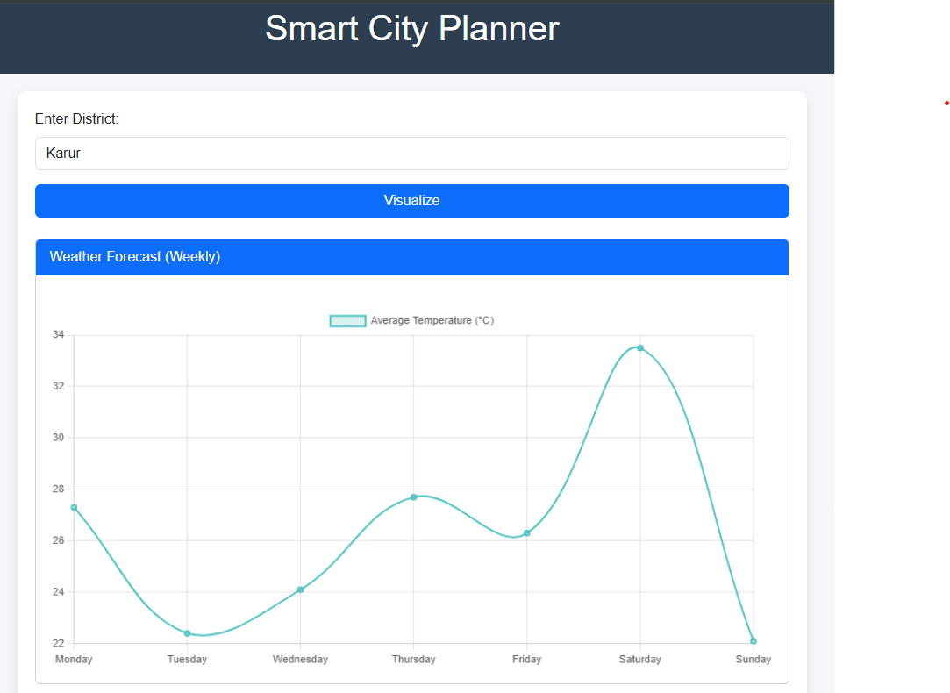
Initial Results and Testing:
Visualization Page: Includes multiple sections with:
Weather trends (line charts).
Energy usage statistics (bar charts).
Traffic density analysis (pie and line charts).
A map pinpointing the selected district.
Weather report

Slide 12
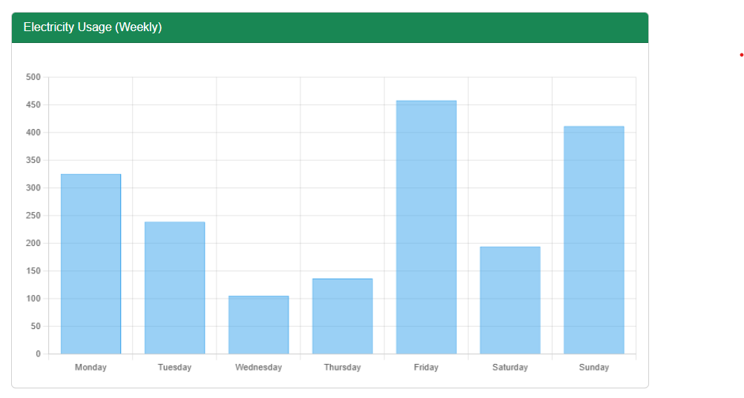
Initial Results and Testing:
Visualization Page: Includes multiple sections with:
Weather trends (line charts).
Energy usage statistics (bar charts).
Traffic density analysis (pie and line charts).
A map pinpointing the selected district.
Power report

Slide 13
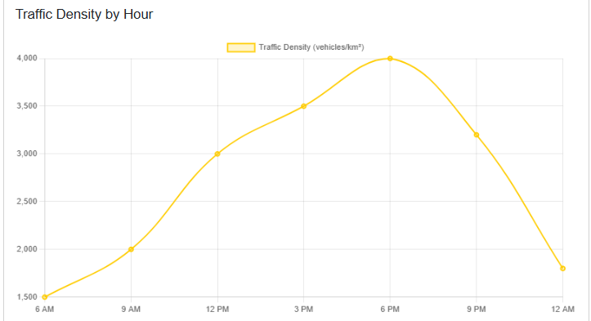
Initial Results and Testing:
Traffic Chart: Chennai's traffic density chart shows peak hours between 6 PM and 9 PM.
Map: Pinpoints district centers precisely using OpenStreetMap tiles.
Traffic report

Slide 14
Challenges and Solutions
Problem:
The map didn't update dynamically to center on the searched district.
User inputs were case-sensitive, causing mismatches for valid districts.
Charts lagged due to multiple simultaneous rendering requests
UI components were not scaling properly on smaller screens.
No guidance was provided for incorrect district names.
Solution:
Implemented JavaScript logic to update the map’s view using Leaflet's setView() function with district-specific coordinates.
Applied .str.lower() to standardize input and data matching.
Optimized Chart.js rendering by caching datasets and reducing redundant data fetches.
Added error messages with suggestions and a fallback option to re-enter data.
Used Bootstrap's grid system to ensure charts and maps are responsive.

Slide 15



Any queries

